Slide 1
Subsurface scattering
Jaroslav Křivánek, KSVI, MFF, UK
Jaroslav.Krivanek@mff.cuni.cz

Slide 2
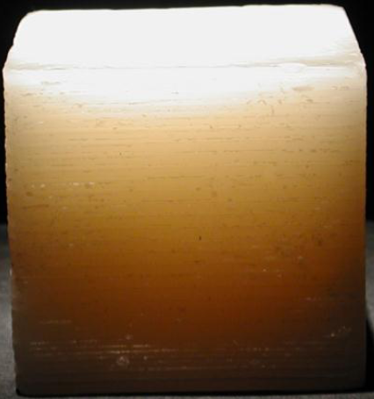
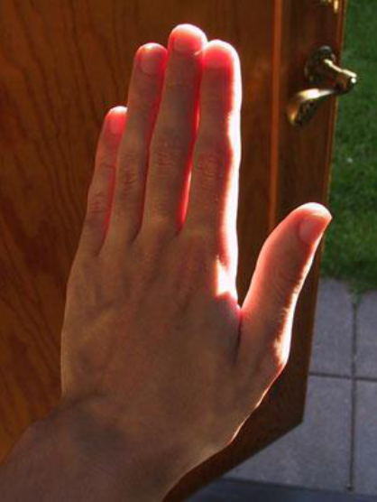
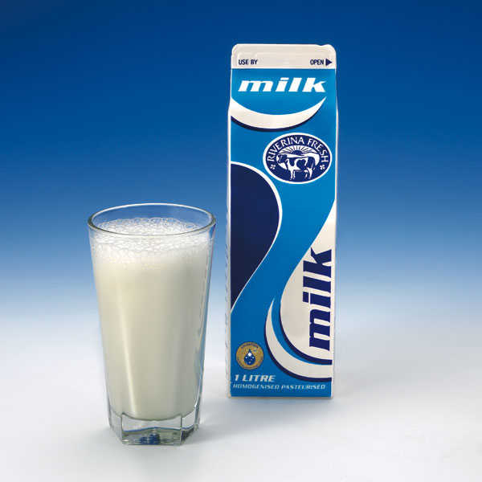
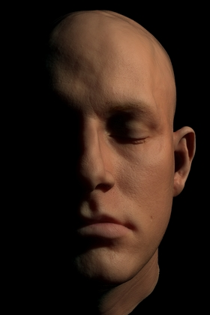
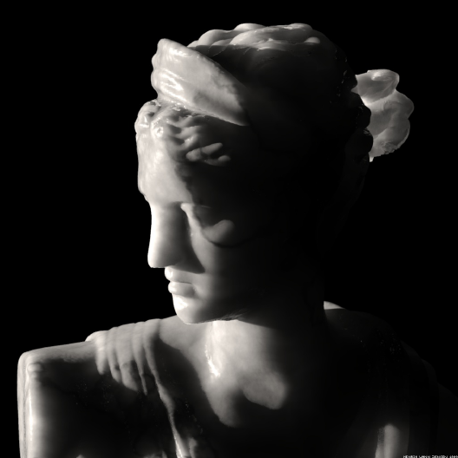
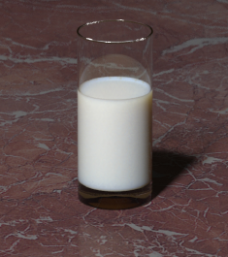
Subsurface scattering examples
Real
Simulated

Slide 3
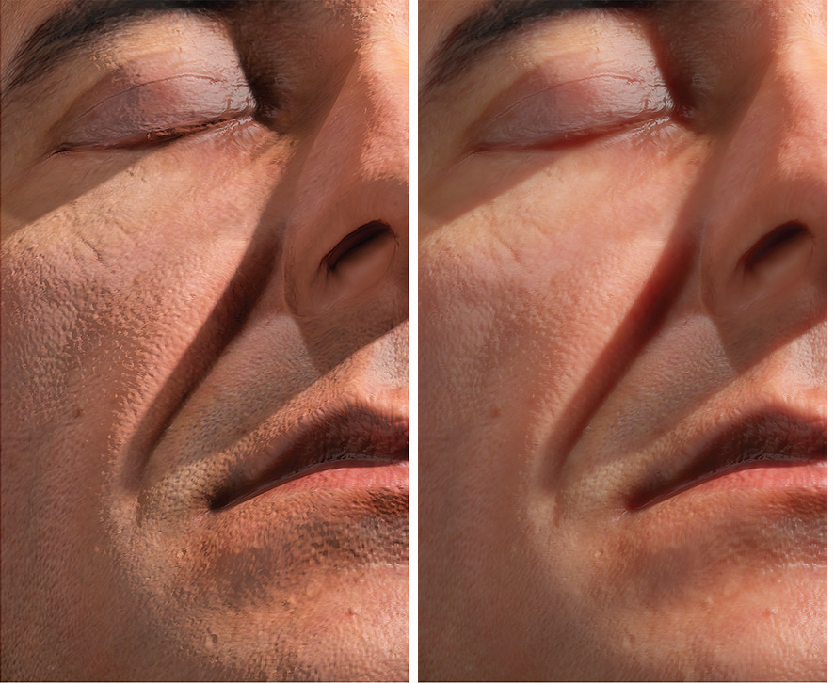

Slide 4
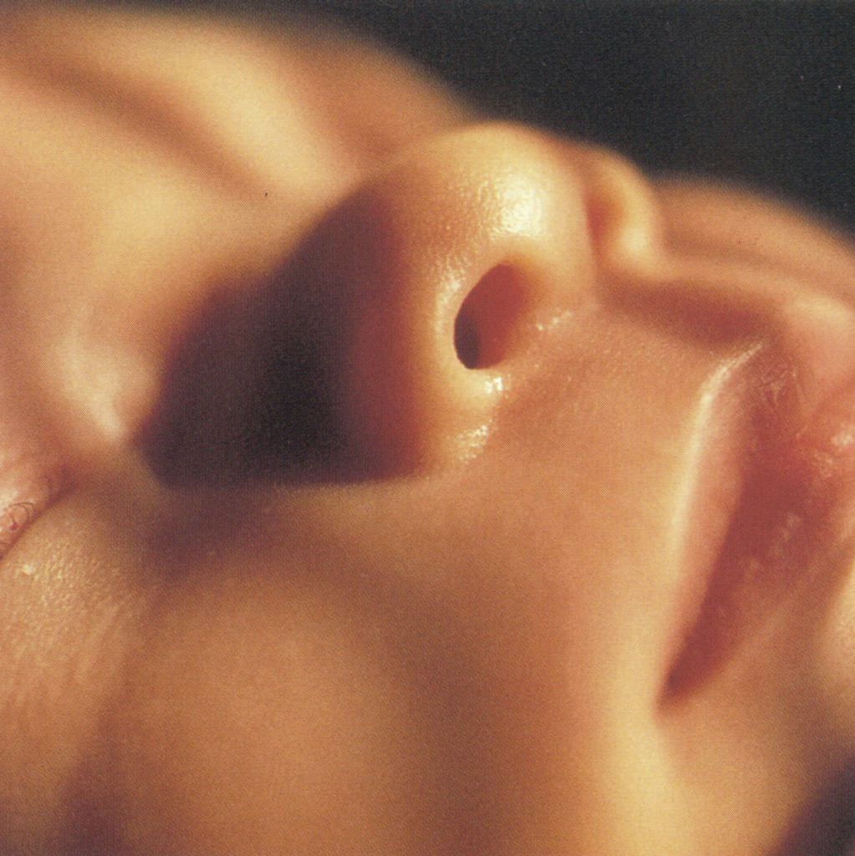

Slide 5
Video

Slide 6
BSSRDF
Bidirectional surface scattering distribution function [Nicodemus 1977]
8D function (2x2 DOFs for surface + 2x2 DOFs for dirs)
Differential outgoing radiance per differential incident flux (at two possibly different surface points)
Encapsulates all light behavior under the surface

Slide 7
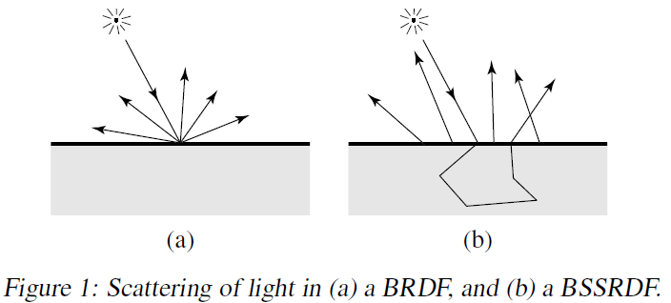
BSSRDF vs. BRDF
BRDF is a special case of BSSRDF (same entry/exit pt)

Slide 8
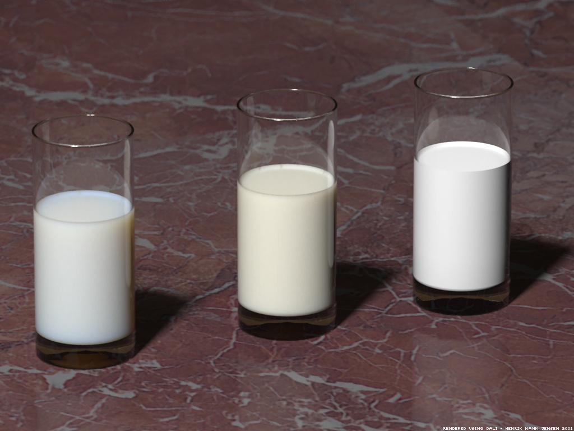
BSSRDF vs. BRDF examples 1
BSSRDF
BRDF

Slide 9
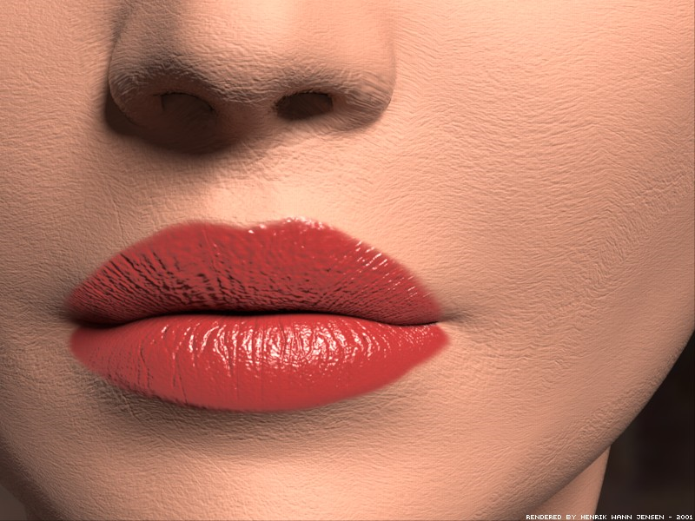
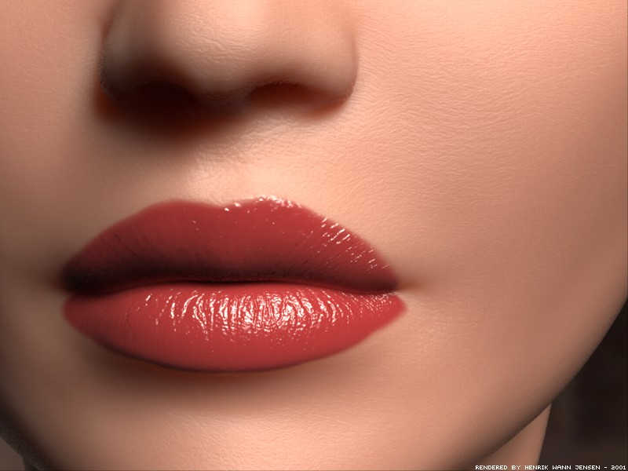
BSSRDF vs. BRDF examples
BRDF – hard, unnatural appearance
BRDF
BSSRDF

Slide 10
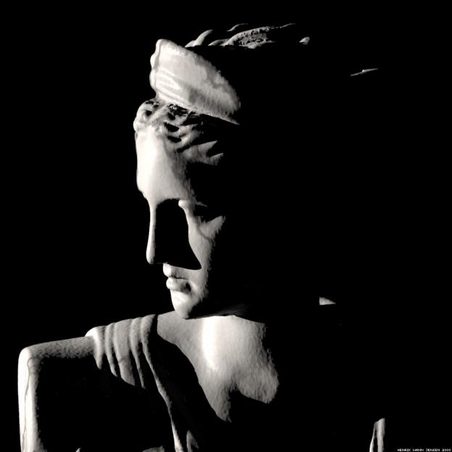
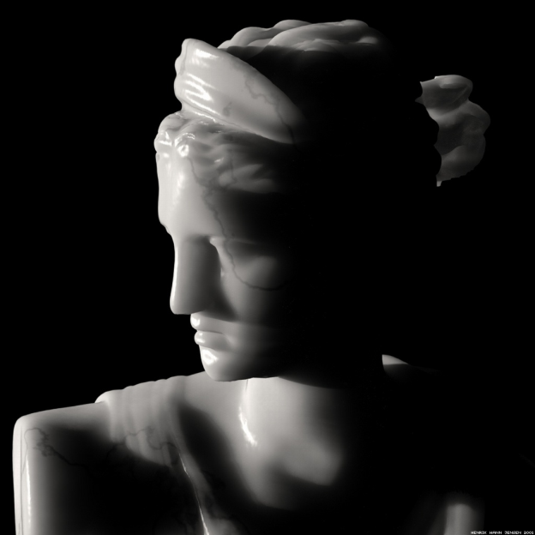
BSSRDF vs. BRDF examples
Show video (SIGGRAPH 2001 Electronic Theater)
BRDF
BSSRDF

Slide 11
BSSRDF vs. BRDF
Some BRDF model do take subsurface scattering into account (to model diffuse reflection)
[Kruger and Hanrahan 1993]
BRDF assumes light enters and exists at the same point (not that there isn’t any subsurface scattering!)

Slide 12
Generalized reflection equation
Remember that
So total outgoing radiance at x_{o} in direction ω_{o} is
(added integration over the surface)

Slide 13
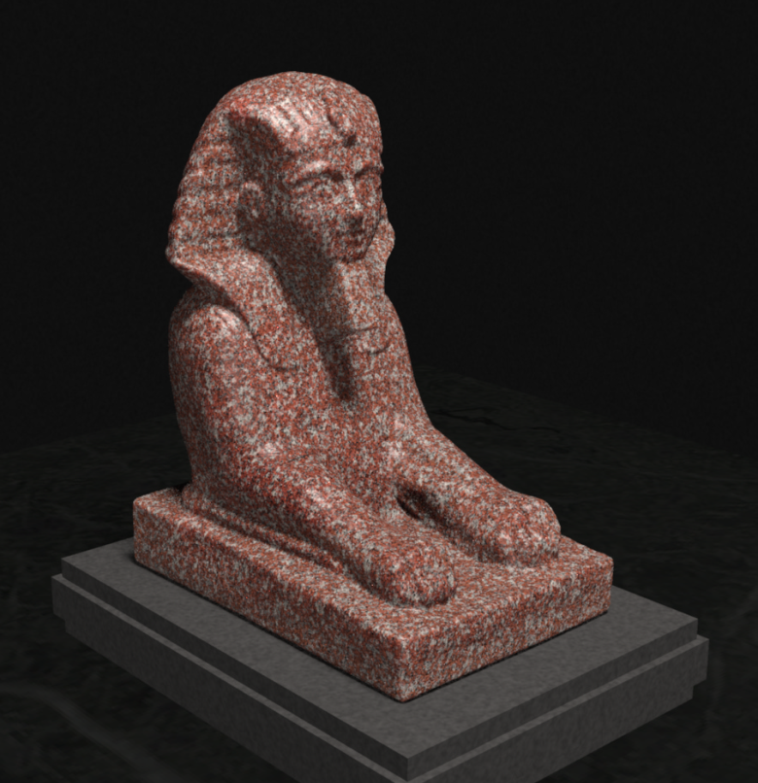
Subsurface scattering simulation
Path tracing – way too slow
Photon mapping – practical [Dorsey et al. 1999]

Slide 14
Simulating SS with photon mapping
Special instance of volume photon mapping [Jensen and Christensen 1998]
Photons distributed from light sources, stored inside objects as they interact with the medium
Ray tracing step enters the medium and gather photons

Slide 15
Problems with MC simulation of SS
MC simulations (path tracing, photon mapping) can get very expensive for high-albedo media (skin, milk)
High albedo means little energy lost at scattering events
Many scattering events need to be simulated (hundreds)
Example: albedo of skim milk, a = 0.9987
After 100 scattering events, 87.5% energy retained
After 500 scattering events, 51% energy retained
After 1000 scattering events, 26% energy retained
(compare to surfaces, where after 10 bounces most energy is usually lost)

Slide 16
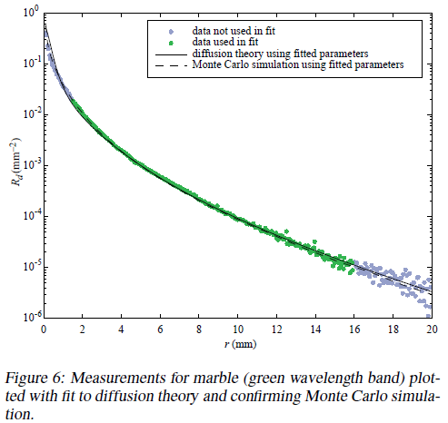
Practical model for subsurface scattering
Jensen, Marschner, Levoy, and Hanrahan, 2001
Won Academy award (Oscar) for this contribution
Can find a diffuse BSSRDF R_{d}(r), where r = ||x₀ – x_{i}||
1D instead of 8D !

Slide 17
Practical model for subsurface scattering
Several key approximations that make it possible
Principle of similarity
Approximate highly scattering, directional medium by isotropic medium with modified (“reduced”) coefficients
Diffusion approximation
Multiple scattering can be modeled as diffusion (simpler equation than full RTE)
Dipole approximation
Closed-form solution of diffusion can be obtained by placing two virtual point sources in and outside of the medium

Slide 18
Approx. #1: Principle of similarity
Observation
Even highly anisotropic medium becomes isotropic after many interactions because every scattering blurs light
Isotropic approximation

Slide 19
Approx. #1: Principle of similarity
Anisotropically scattering medium with high albedo approximated as isotropic medium with
reduced scattering coefficient:
reduced extinction coefficient:
(absorption coefficient stays the same)
Recall that g is the mean cosine of the phase function:
Equal to the anisotropy parameter for the Henyey-Greenstein phase function

Slide 20
Reduced scattering coefficient
Strongly forward scattering medium, g = 1
Actual medium: the light makes a strong forward progress
Approximation: small reduced coeff => large distance before light scatters
Strongly backward scattering medium, g = -1
Actual medium: light bounces forth and back, not making much progress
Approximation: large reduced coeff => small scattering distance

Slide 21
Approx. #2: Diffusion approximation
We know that radiance mostly isotropic after multiple scattering; assume homogeneous, optically thick
Approximate radiance at a point with just 4 SH terms:
Constant term: scalar irradiance, or fluence
Linear term: vector irradiance

Slide 22
Diffusion approximation
With the assumptions from previous slide, the full RTE can be approximated by the diffusion equation
Simpler than RTE (we’re only solving for the scalar fluence, rather than directional radiance)
Skipped here, see [Jensen et al. 2001] for details

Slide 23
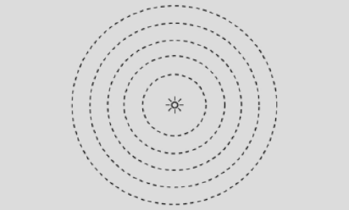
Solving diffusion equation
Can be solved numerically
Simple analytical solution for point source in infinite homogeneous medium:
Diffusion coefficient:
Effective transport coefficient:
source flux
distance to source

Slide 24
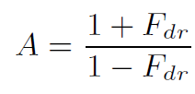
Solving diffusion equation
Our medium not infinite, need to enforce boundary condition
Radiance at boundary going down equal to radiance incident at boundary weighed by Fresnel coeff (accounting for reflection)
Fulfilled, if φ(0,0,2AD) = 0 (zero fluence at height 2AD)
where
Diffuse Fresnel reflectance
approx as

Slide 25
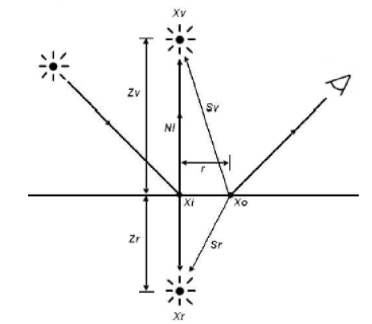
Dipole approximation
Fulfill φ(0,0,2AD) = 0 by placing two point sources (positive and negative) inside and above medium
one mean free path below surface

Slide 26
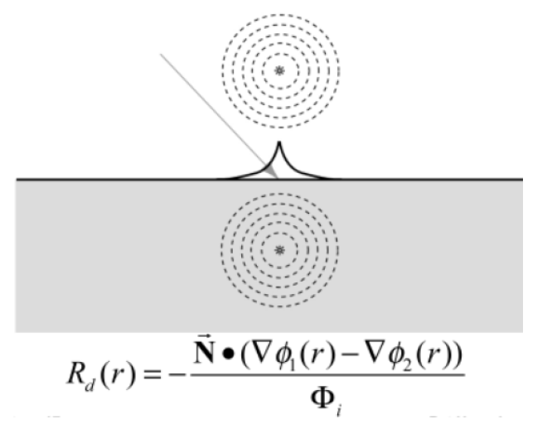
Dipole approximation
Fluence due to the dipole (d_{r} … dist to real, d_{v} .. to virtual)
Diffuse reflectance due to dipole
We want radiant exitance (radiosity) at surface…
(gradient of fluence )
… per unit incident flux

Slide 27
Diffuse reflectance due to dipole
Gradient of fluence per unit incident flux
gradient in the normal
direction = derivative w.r.t. z-axis

Slide 28
Diffusion profile
Plot of R_{d}

Slide 29
Final diffusion BSSRDF
Diffuse multiple-scattering reflectance
Normalization term (like for surfaces)
Fresnel term for incident light
Fresnel term for outgoing light

Slide 30
Single scattering term
Cannot be accurately described by diffusion
Much shorter influence than multiple scattering
Computed by classical MC techniques (marching along ray, connecting to light source)

Slide 31
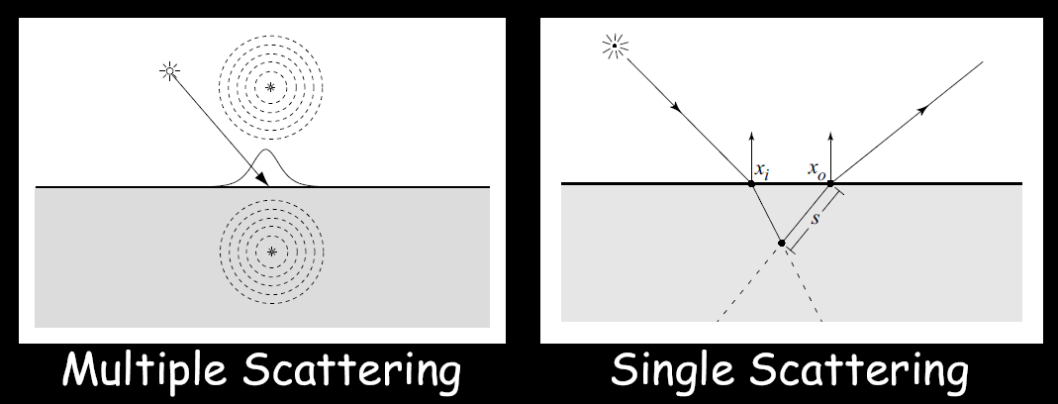
Complete BSSRDF model

Slide 32
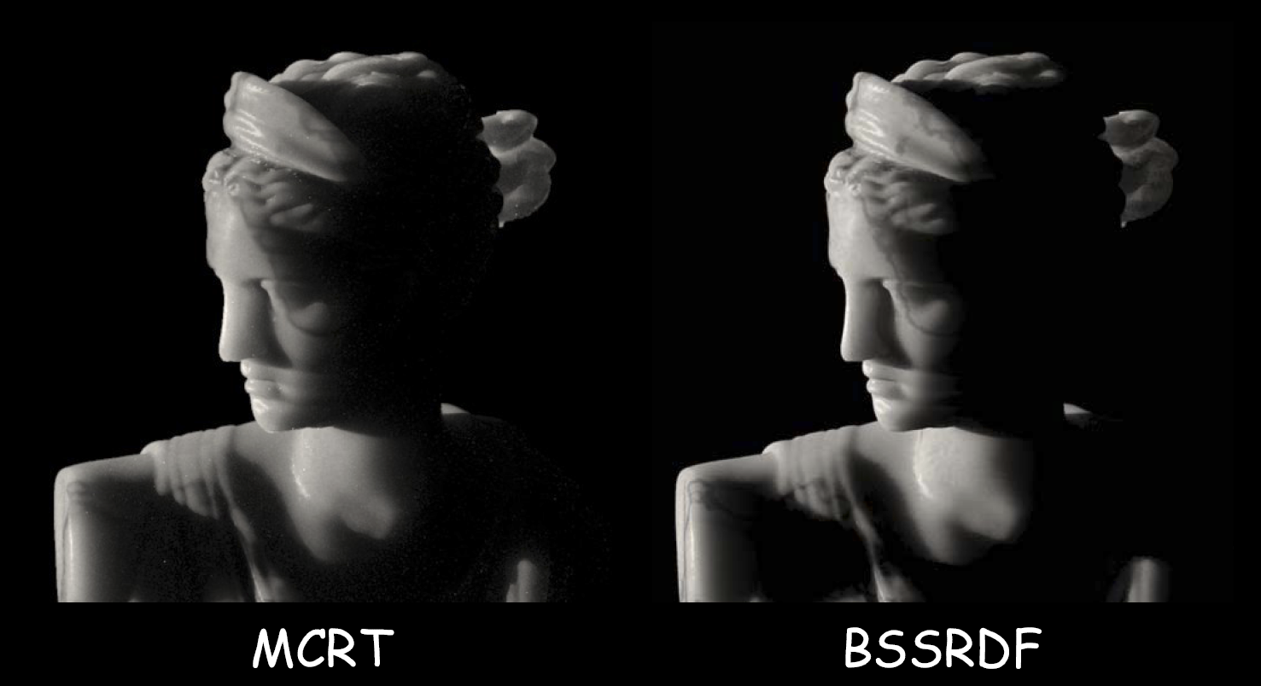
MC simulation vs. BSSRDF model

Slide 33
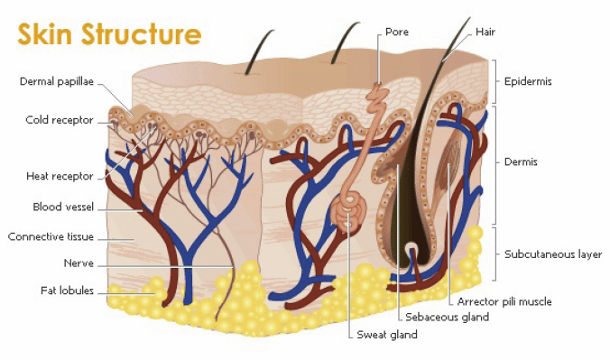
Multiple Dipole Model
Skin is NOT an semi-infinite slab

Slide 34
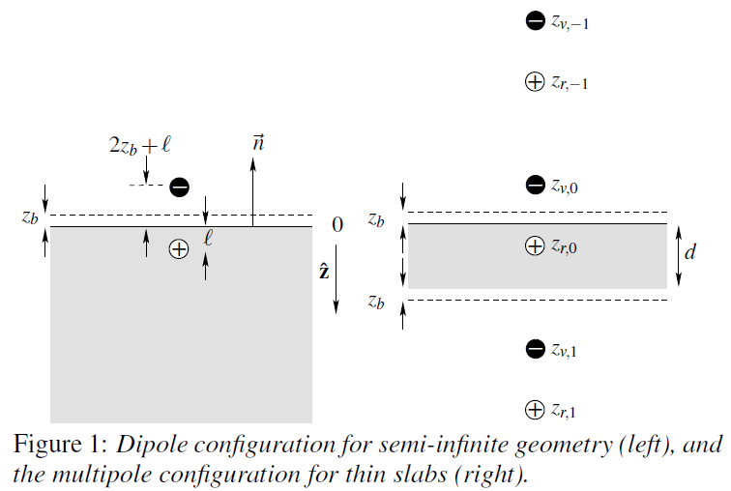
Multiple Dipole Model
[Donner and Jensen 2005]
Dipole approximation assumed semi-infinite homogeneous medium
Many materials, namely skin, has multiple layers of different optical properties and thickenss
Solution: infinitely many point sources

Slide 35
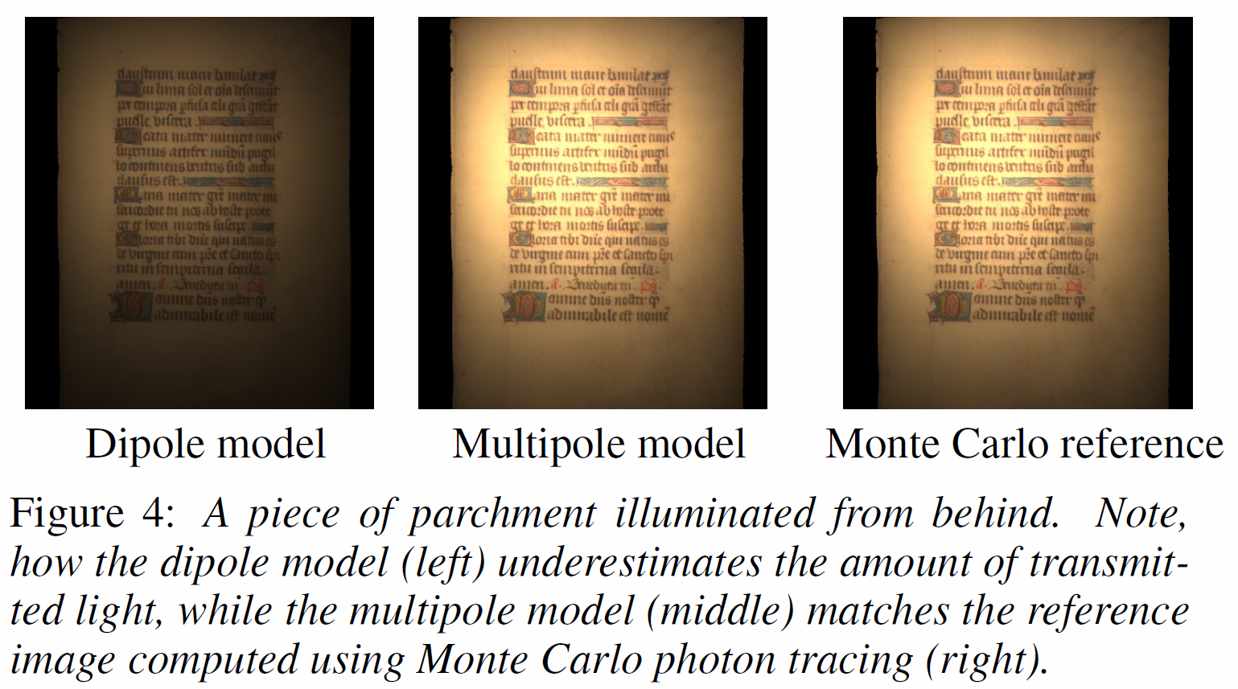
Diplole vs. multipole

Slide 36
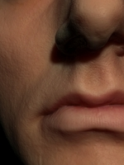
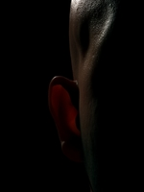
Multiple Dipole Model - Results

Slide 37
Rendering with BSSRDFs

Slide 38
Rendering with BSSRDFs
Monte Carlo sampling [Jensen et al. 2001]
Hierarchical method [Jensen and Buhler 2002]
Real-time approximations [d’Eon et al. 2007, Jimenez et al. 2009]

Slide 39
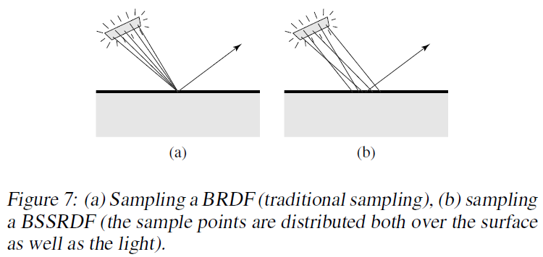
Monte Carlo sampling
[Jensen et al. 2001]

Slide 40
Hierarchical method
[Jensen and Buhler 2002]
Key idea: decouple computation of surface irradiance from integration of BSSRDF
Algorithm
Distribute many points on translucent surface
Compute irradiance at each point
Build hierarchy over points (partial avg. irradiance)
For each visible point, integrate BSSRDF over surface using the hierarchy (far away point use higher levels)

Slide 41
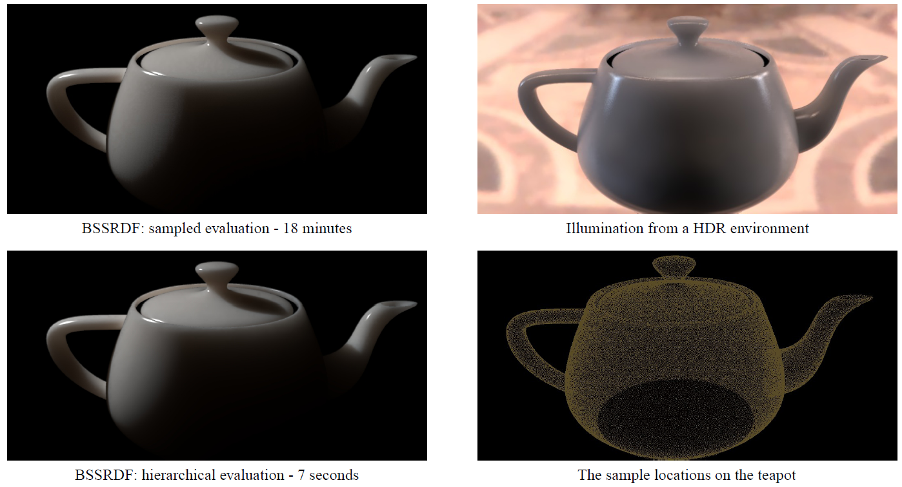
Hierarchical method - Results

Slide 42
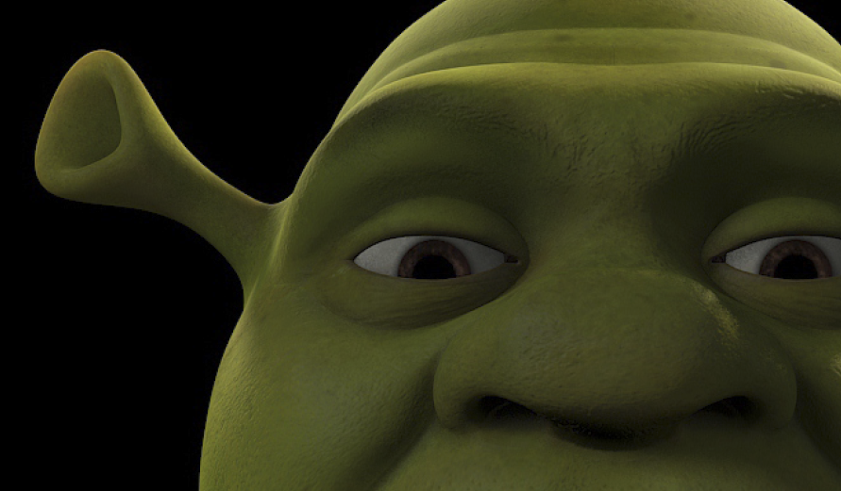
Hierarchical method - Results

Slide 43
Texture-space filtering
[d’Eon et al. 2007]
Idea
Approximate diffusion profile with a sum of Gaussians
Blur irradiance in texture space on the GPU
Fast because 2D Gaussians is separable
Have to compensate for stretch

Slide 44
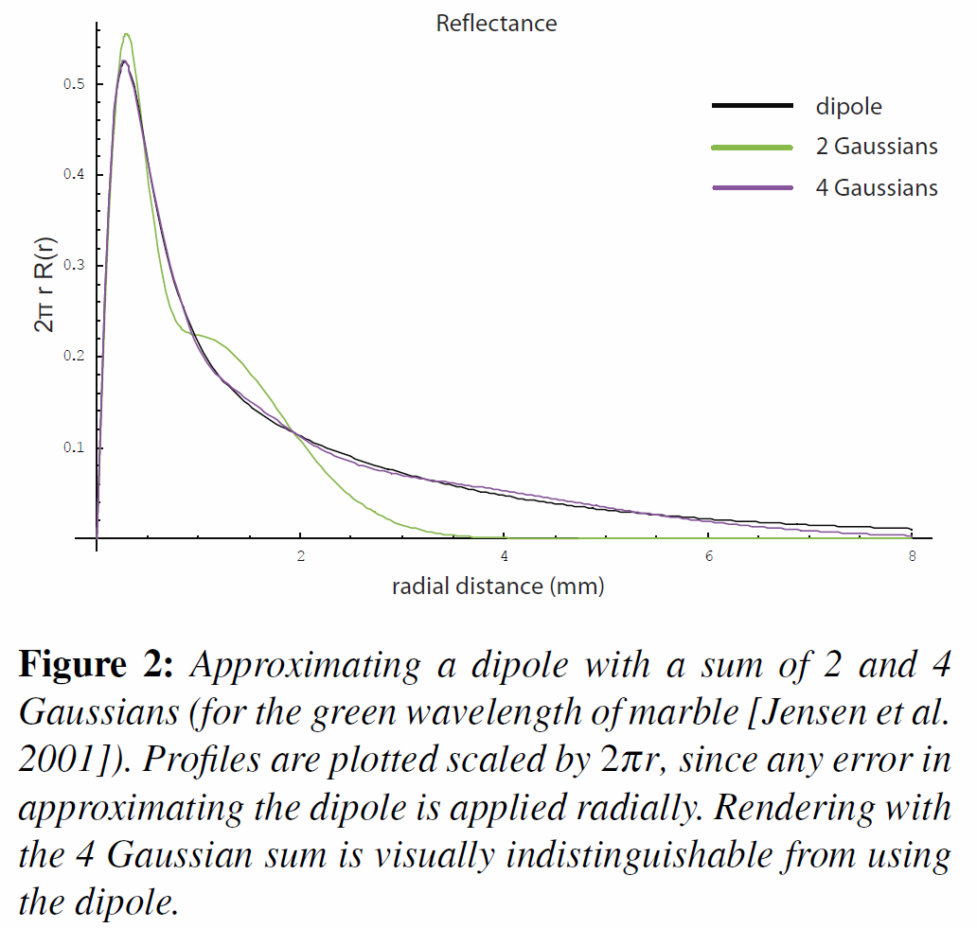
Diffusion profile approximation

Slide 45
Components
Albedo (reflectance) map, i.e. texture
Illumination
Radiosity (=albedo * illum) filtered by the individual Gaussian kernels
Specular reflectance

Slide 46
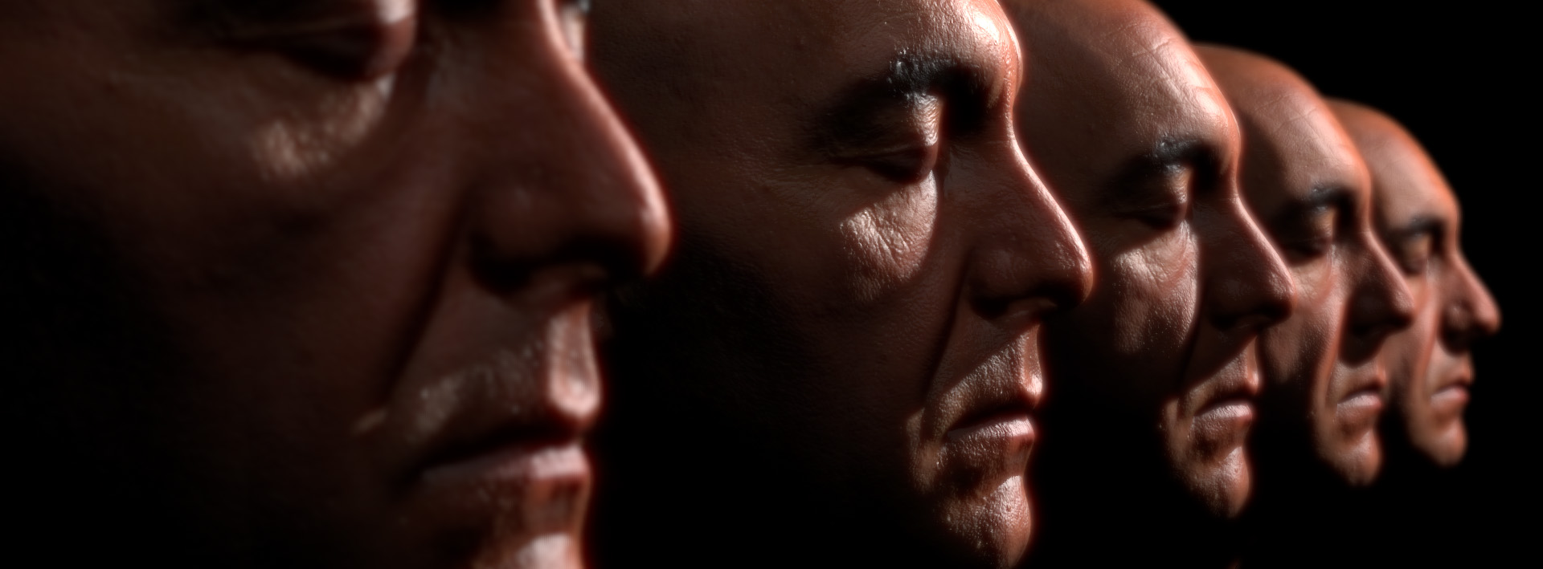
Image space filtering
[Jimenez et al. 2009]
Addresses scalability (think of many small characters in a game)
Used in CryEngine 3 and other

Slide 47
Acquisition of scattering properties

Slide 48
References
PBRT, section 16.5

